Slide 1
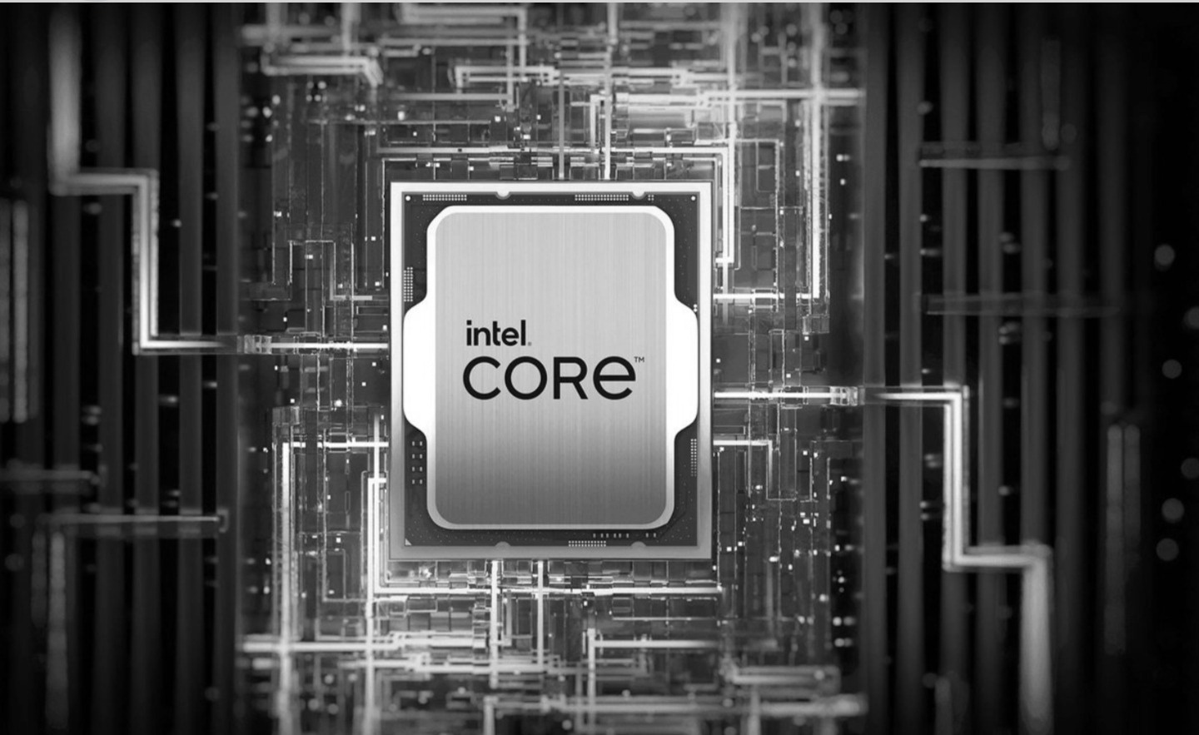
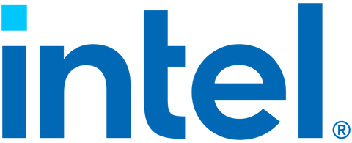
01
Intel Branding
&
Visual Identity
Simplify Your AI Journey
WWW.INTEL.COM

Slide 2
SUMMARY
01
  Introduction
  Target Audience
  Brand Identity
  Color Palette
  Typography
  Logo Evolution
  Brand Application
  Conclusion

Slide 3

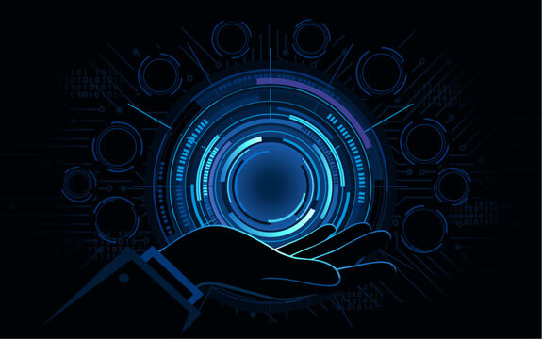

02
Introduction
Company overview :
Intel is a multinational technology company known for designing and manufacturing semiconductor chips, processors, and other computing hardware. Founded in 1968, Intel has become a leader in the tech industry, powering devices and systems worldwide.
Mission statement :
Intel’s mission is to “create world-changing technology that enriches the lives of every person on earth.”
Core values:
  Customer-first
  Fearless innovation
  Diveraity

Slide 4

03
Target Audience
Primary audience:
  Businesses and enterprises (companies needing servers, cloud computing...).
  Tech enthusiasts and Gamers (users of high performance processors).
Secondary audience:
  General consumers (laptop and desktop users).
  Developers and engineers (users of Intel's developer tools and platforms).
Psychographics :
  Interest in technology, innovation and performance .
  Value reliability and quality.

Slide 5
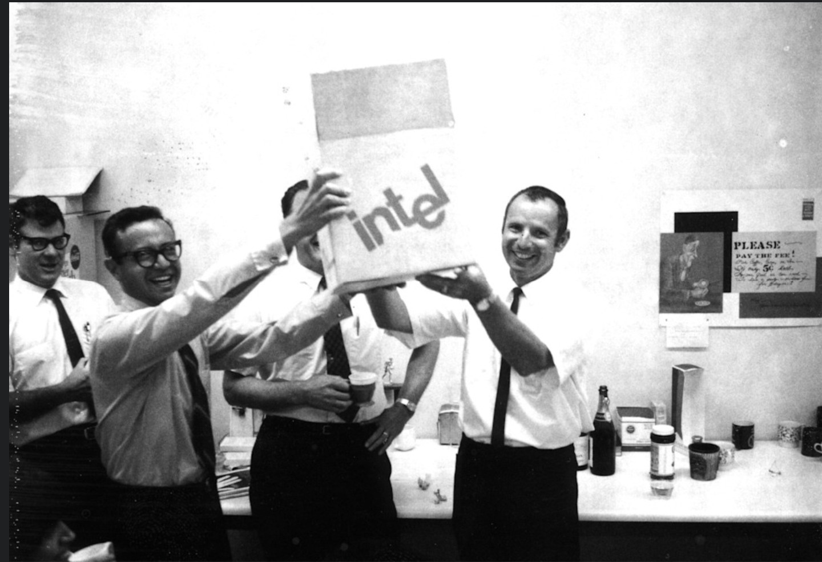
04
Brand Identity
Logo :
Intel's first logo, introduced in 1968, featured a bold, stylized lowercase typeface with the "e" slightly dropped below the baseline, giving it a distinct, industrial look that reflected the company's early focus on microprocessors and innovation. In contrast, the latest logo, unveiled in 2020, adopts a minimalist and modern design with a clean, sans-serif typeface. It removes the old elliptical swirl, emphasizing simplicity and contemporary aesthetics while retaining Intel's signature blue color, mainly in the dot above the "i," symbolizing continuity and the brand’s strong identity.

Slide 6
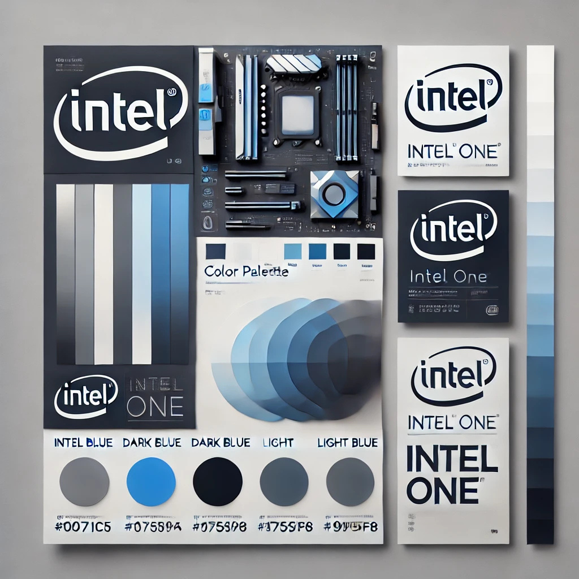
06
Color Palette:
Primary Color: Intel Blue (hex: #0071C5) – Represents trust, reliability, and technology.
Secondary Colors: White, black, and gray – Used for contrast and a clean, professional look.
Typography:
Primary Font: Intel One – A custom sans-serif font designed for Intel. It’s clean, modern, and tech-inspired.
Secondary Font: Arial or Helvetica – Used for supplementary text.

Slide 7
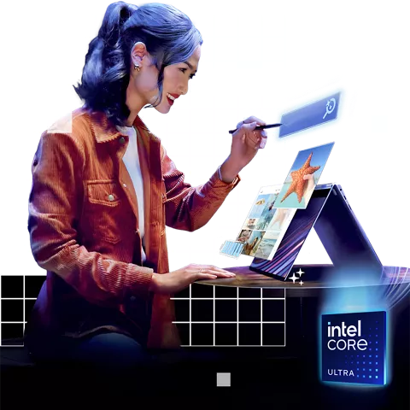
Imagery
07
Intel’s visuals often feature modern, sleek designs with metallic colors, blue tones (its signature color), and high-tech elements that emphasize cutting-edge innovation.
Its campaigns frequently include animations, complex graphics, and 3D renders to showcase the power of its processors.
Tone of Voice
Intel communicates with a strong, authoritative voice, reinforcing its leadership in semiconductors and computing.
Even when discussing complex technical topics, the brand simplifies concepts to make them understandable for a broader audience.

Slide 8


08
BRAND APPLICATION
Website:
  Clean, modern design with a focus on blue and white.
  Easy navigation and clear calls to action (e.g., “Learn More,” “Shop Now”).
Social Media:
  Consistent use of Intel Blue and futuristic imagery.
  Engaging content, including product launches, tech tips, and innovation stories.
Advertising:
  TV and online ads often feature sleek visuals of Intel-powered devices and emphasize performance and innovation.
Example : Intel’s “Meet the Makers” campaign highlights creators using Intel technology.
Packaging:
  Minimalist design with the Intel logo and product details.
  Focus on blue and white for consistency.

Slide 9

09
CONCLUSION
This Intel’s visual documentation showcases a clear, modern, and innovative approach to presenting complex technologies. Through consistent design, structured layouts, and engaging visuals, it enhances understanding while maintaining a professional tone. This approach not only strengthens Intel’s brand identity but also ensures an intuitive and informative experience for users. By bridging technical depth with accessibility, Intel effectively communicates its role as a leader in computing technology.

Slide 10

10
THANK YOU
  gsehaki@stumail.jccc.edu
  12345 College Blvd
  @gana.sehaki

